Slide 1

E-commence Data Analysis
Future Data Analysts
PrideNgomane/E-commence-Data-Analysis

Slide 2


Introduction to Web-Scraping Presentation
Tools used
Libraries Used
- BeautifulSoup
- Request and Json
- Pandas
- Matplotlib and Seaborn
-Numpy
Anaconda (Jupiter Notebook)

Slide 3

Phase 1: Web Scraping
1. What is Web-Scraping?
2. Why Web-Scraping?
3. Selected data to analyze
Title
Price
Rating
Availability
Review counts
4. Tools and Technologies
Requests: Fetches HTML content.
BeautifulSoup: Parses and extracts data

Slide 4
Phase 2: Data Cleaning using Pandas lib
Removing missing or duplicate data.
Converting price columns to numerical values.
Normalizing ratings.
Handle outliers.

Slide 5
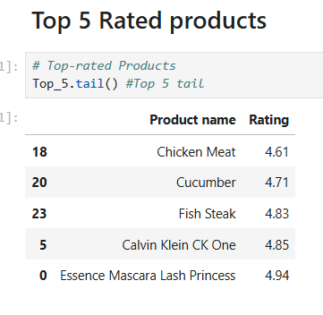
Phase 3: Exploratory Data Analysis
Top-rated products.
Price distribution.
price vs. rating correlation.
Summarize trends
1
2
3
4

Slide 6
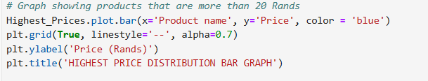
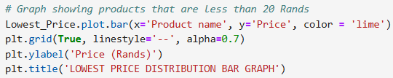
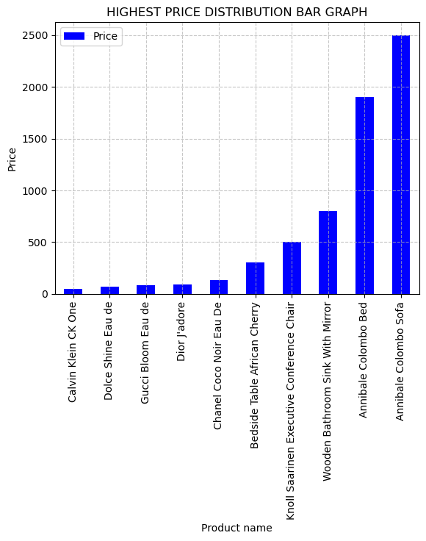
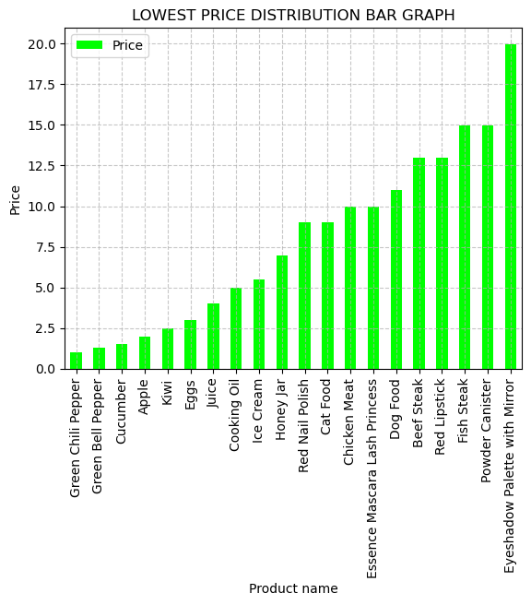

Slide 7
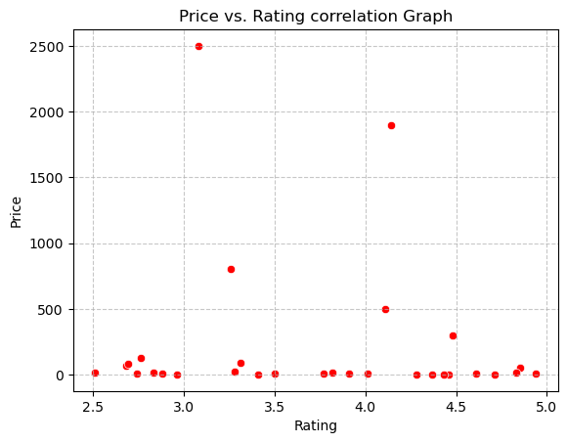
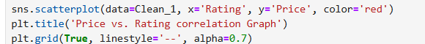
PRICE VS RATING CORRELATION

Slide 8

Recommendation and Insights
Focus on
High-Value Products
Enhance
Product Quality
Leverage
Customer Feedback
Optimize
Pricing Strategy
Improve
Shipment Duration

Slide 9

Conclusion
Implementing these insights and recommendations will enhance market positioning, improve customer satisfaction, and drive sales growth in the e-commerce landscape.

Slide 10

Thank you….

